Slide 1

CSCI 232: Data Structures and Algorithms
Lecture 1: Syllabus, and Logistics
Reese Pearsall
Summer 2023
https://www.cs.montana.edu/pearsall/classes/summer2023/232/main.html

Slide 2
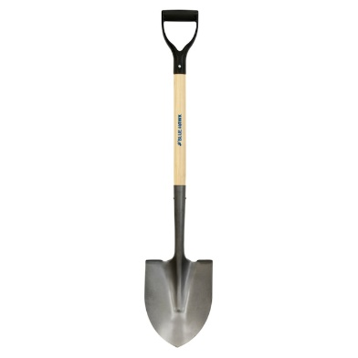
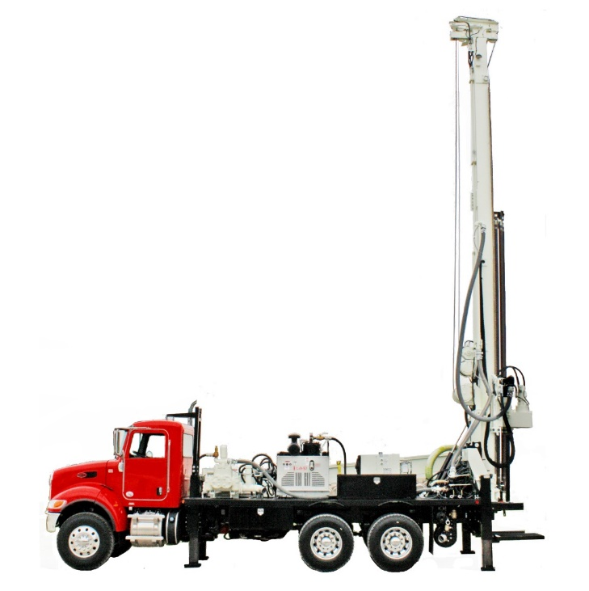

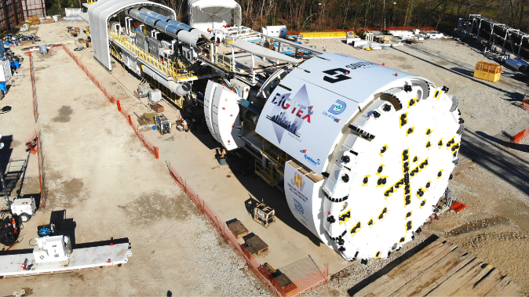
What do you need to dig a hole?
We have many tools that will dig a hole

Slide 3
What do you need to dig a hole?
We have many tools that will dig a hole
Best tool for the job?

Slide 4
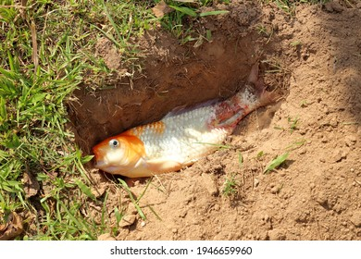

What do you need to dig a hole?
We have many tools that will dig a hole
Burying your pet goldfish
Best tool for the job?

Slide 5
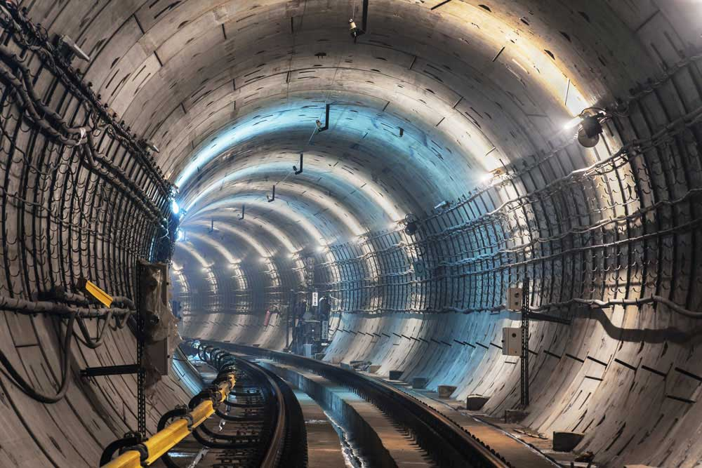

What do you need to dig a hole?
We have many tools that will dig a hole
Building Express tunnel to Bridger Bowl
Best tool for the job?

Slide 6
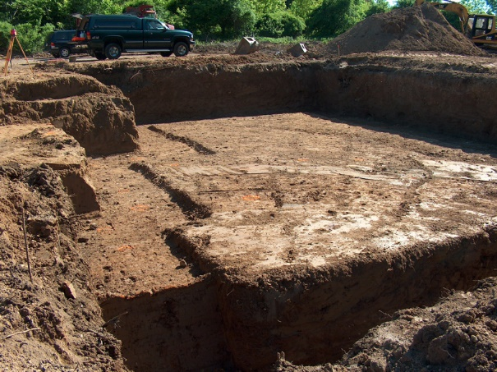

What do you need to dig a hole?
We have many tools that will dig a hole
Creating the foundation for a house
Best tool for the job?

Slide 7
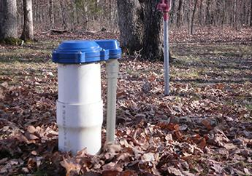

What do you need to dig a hole?
We have many tools that will dig a hole
Best tool for the job?
Digging a Well for water
We can’t use the best tool for the job unless we know that tool exists!

Slide 8
What do you need to dig a hole?
Pros
Cons
Cheap
Precise
No Training
Availability
Each tool has their pros, cons, and tradeoffs
Slow
Labor
Fast
Labor
Expensive
Training
Really good at digging
Takes up a lot of garage space

Slide 9
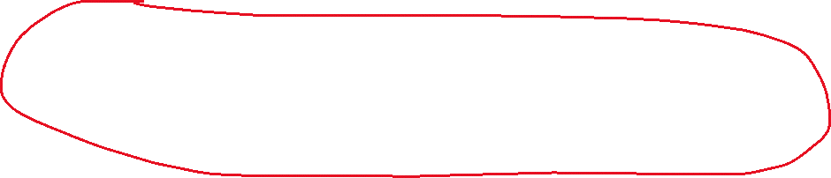
What do you need to dig a hole?
Pros
Cons
Cheap
Precise
No Training
Availability
Each tool has their pros, cons, and tradeoffs
Slow
Labor
Fast
Labor
Expensive
Training
Really good at digging
Takes up a lot of garage space

Slide 10
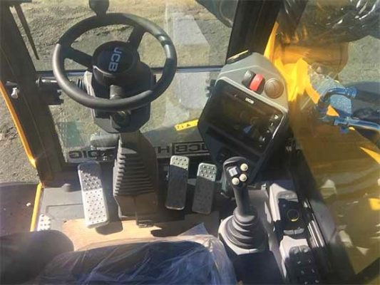
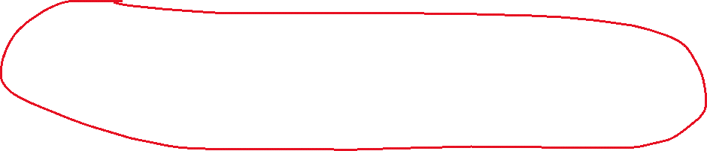
What do you need to dig a hole?
Pros
Cons
Cheap
Precise
No Training
Availability
Each tool has their pros, cons, and tradeoffs
Slow
Labor
Fast
Labor
Expensive
Training
Really good at digging
Takes up a lot of garage space

Slide 11
What do you need to dig a hole?
Pros
Cons
Cheap
Precise
No Training
Availability
Each tool has their pros, cons, and tradeoffs
Slow
Labor
We can’t use the best tool for the job unless we know how to use that tool
Fast
Labor
Expensive
Training
Really good at digging
Takes up a lot of garage space

Slide 12


CSCI 232- Data Structures and Algorithms
“Tools”
Arrays
Linked Lists
Stacks/Queues
Hash Tables
Trees
Graphs
“Use of tools”
Sorting
Searching
Routing
A data structure is a mechanism for storing and organizing data
An algorithm is a series of instructions to be followed to solve some problem

Slide 13
Our Goals for the Summer
Code (a lot)
Learn important data structures we can use in our programs (Trees, Hash Tables, Graphs)
Learn how we can use those data structures to solve problems (Searching, Sorting, Routing)
Learn techniques used by algorithms to solve a variety of problems (Greedy, Dynamic Programming, Divide and Conquer)
Analyze the complexity and runtime of the algorithms that we write (Big-O notation)

Slide 14
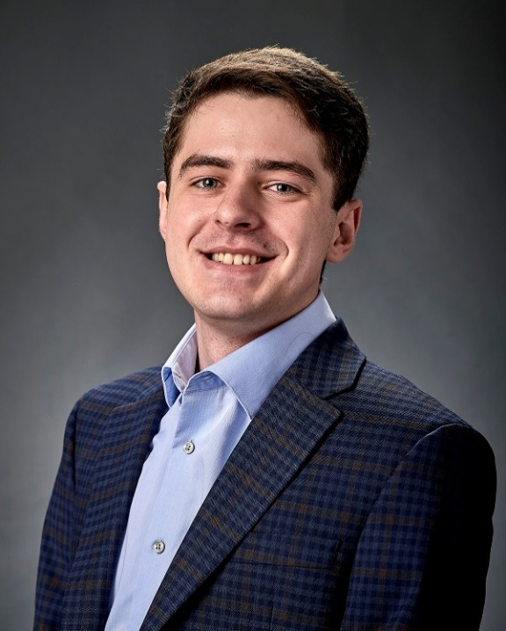
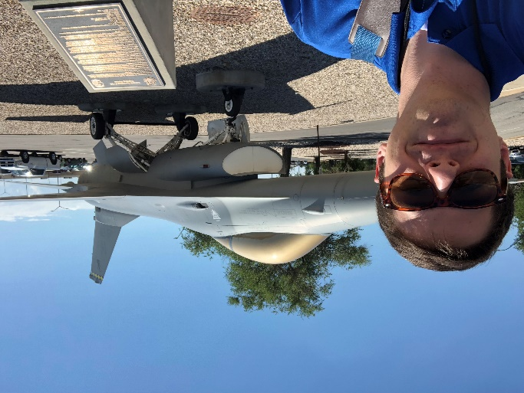
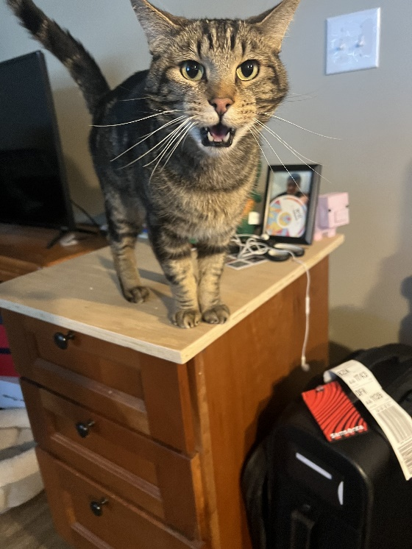
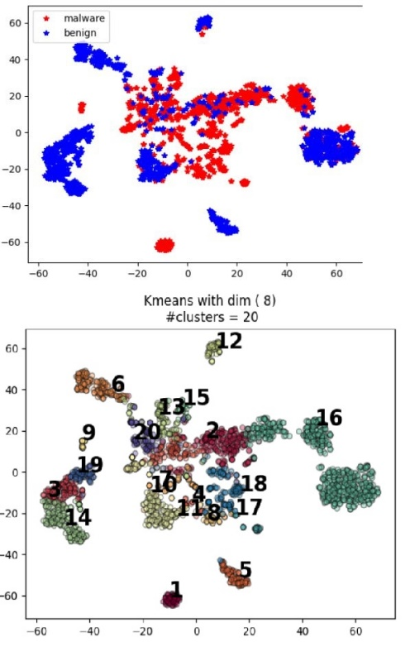

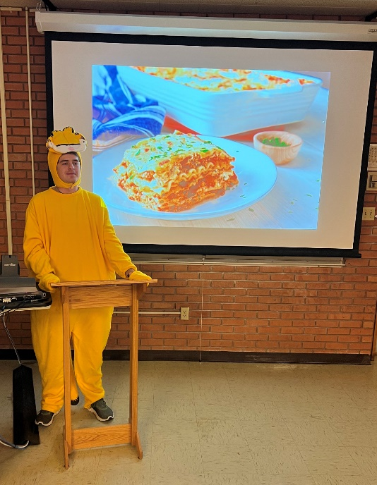

Reese Pearsall
(pierce-all)
First year Instructor @MSU
B.S & M.S @ MSU
Hometown
Billings, MT
Interests
Cybersecurity
Malware analysis and detection
Cybercrime
Computer Science Education
Teaching
CSCI 132
CSCI 455
CSCI 476
Experience
Software Engineer and Tester, Techlink (Bozeman)
Software Engineer, United States Air Force (Hill AFB, Utah)
Software Engineer, Hoplite Industries (Bozeman)
Graduate Researcher, MSU (Bozeman)
Outside of academia
Video games, New England Patriots, Fantasy Football, TikTok, Movies, Memes,The Bachelor, Naps

Slide 15
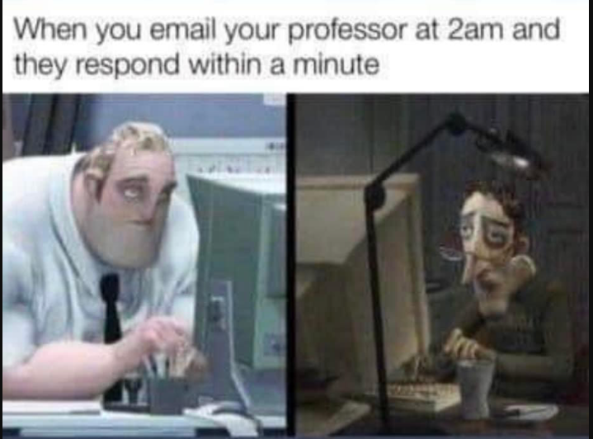
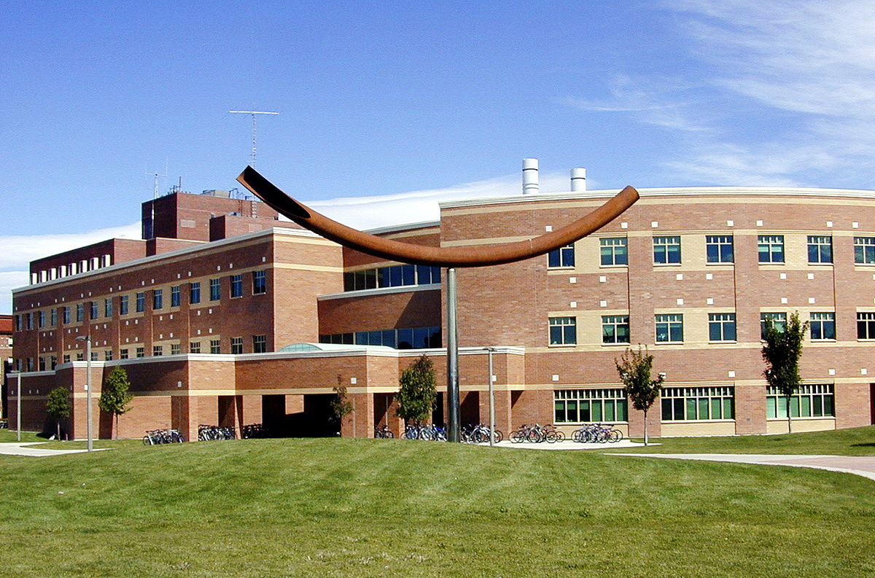
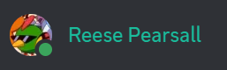

Contact
Email: reese.pearsall@montana.edu (I will respond as soon as I can)
Office Hours: Tuesdays and Thursdays 12:30 – 1:30 PM and during lab time
Office: Barnard Hall 361
Webex Room: https://montana.webex.com/meet/b37k331
You can schedule a time to meet with me via my appointment scheduler (Link TBD)
Not available on Fridays
I am also very responsive on Discord!
(Reese#7171)

Slide 16
Course Logistics (Lecture)
Class Meetings
MTWR: 10:00 AM – 12:20 PM
Barnard Hall 126
*there will be a few days where we must meet somewhere else
All lectures will be recorded and put on the website (this class can be taken fully remotely), and maybe even livestreamed?
I will lecture for about 60-90 minutes each day, and remaining time will be “lab time”
We will be doing lots of live coding during lecture, so it might be helpful if you bring your own laptop to class (if you would like to code along)

Slide 17
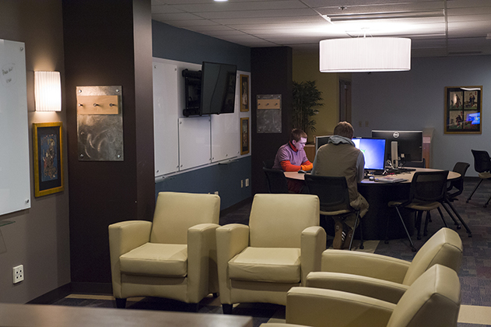
Course Logistics (“Lab”)
11:00/11:30-ish to 12:20 PM
(depending on how long I lecture for)
Locations: Barnard Hall 254
Attendance is not required
I will be available virtually (via Webex) and in-person to help with any assignments

Slide 18
Taking a Summer Class
This is a 6-week Summer class. We cover 16-weeks of content in only 6 weeks.
This class moves fast, and you can expect 1-2 assignments due every week.
Do not fall behind, and do not slack off, otherwise this class will be tough
You probably won’t learn as much compared to a 16-week offering of 232 ☺
Be ready to put in several hours a week into this class.
I am very flexible– I understand people have summer plans and are working part-time/full-time. If you need anything just let me know
This class can be taken fully online/remotely

Slide 19
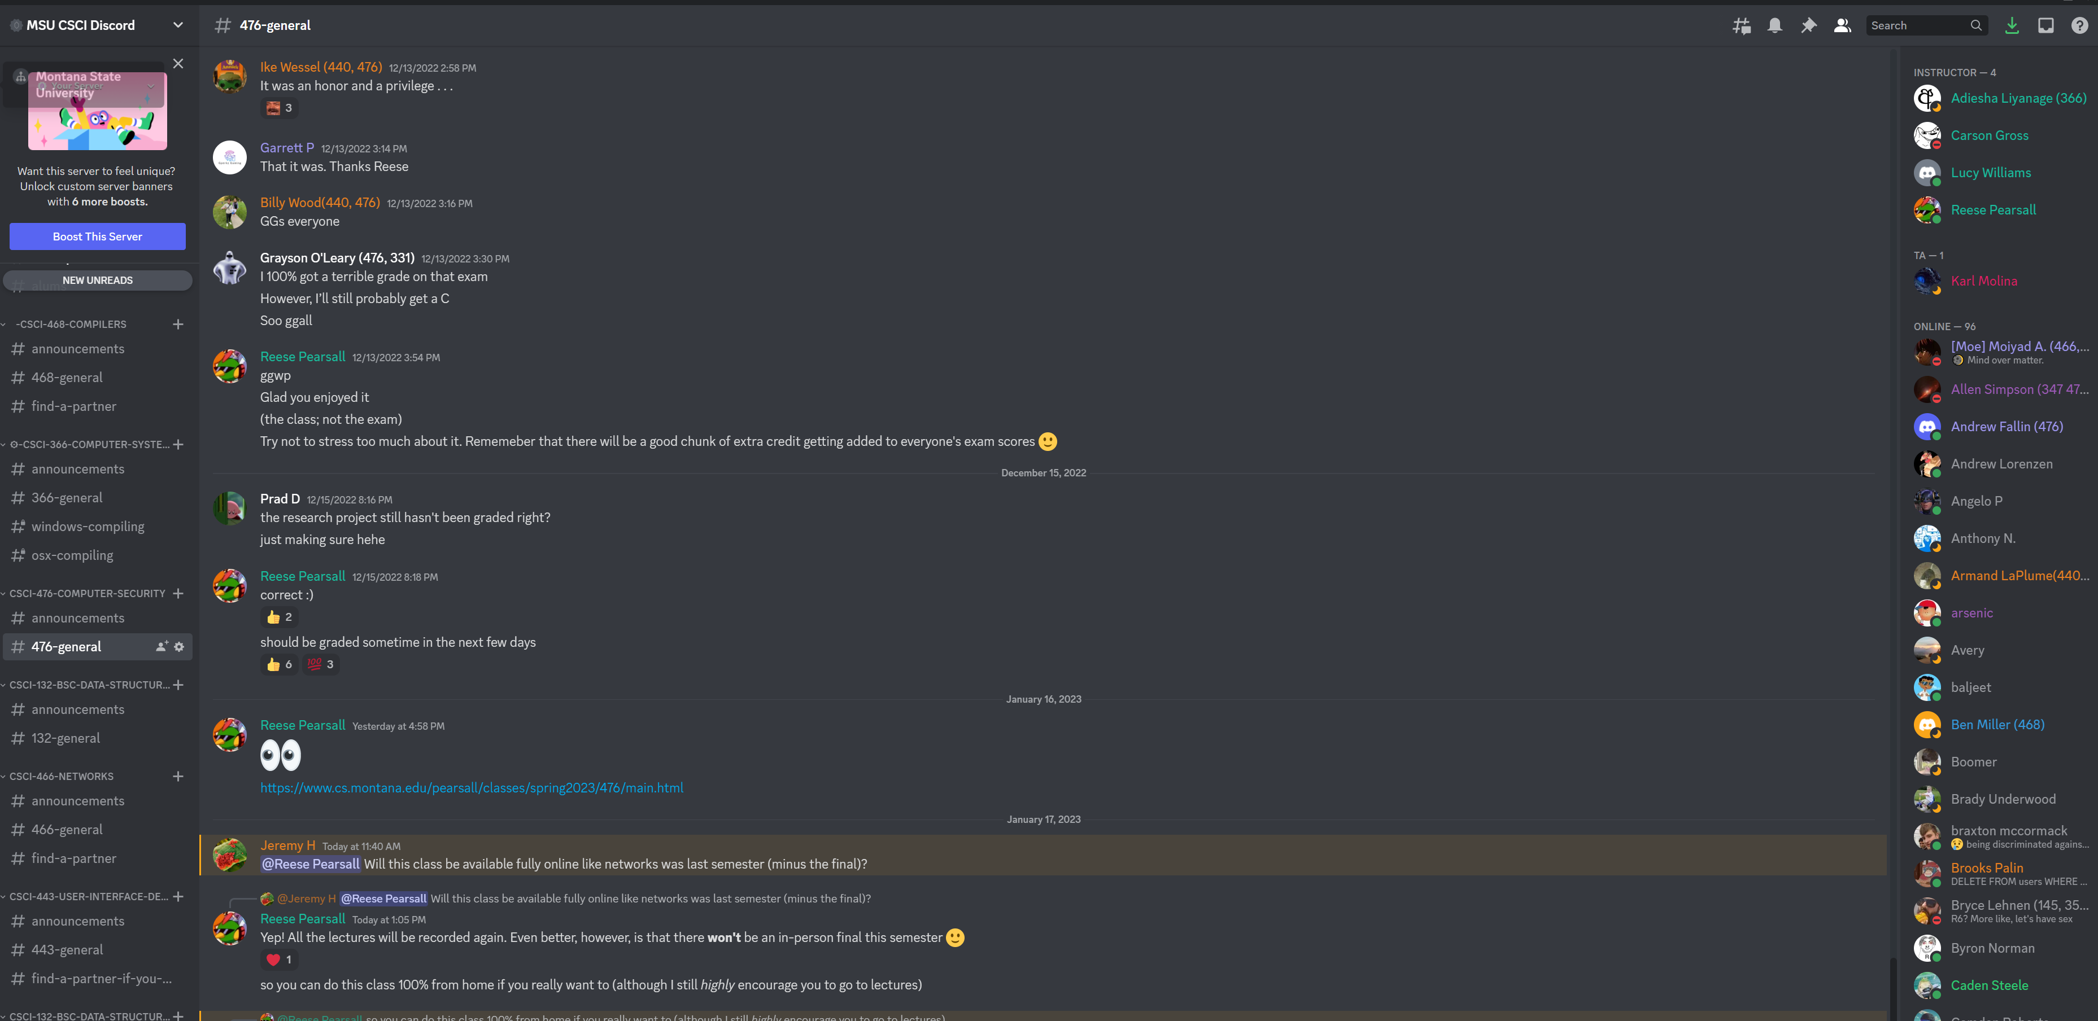
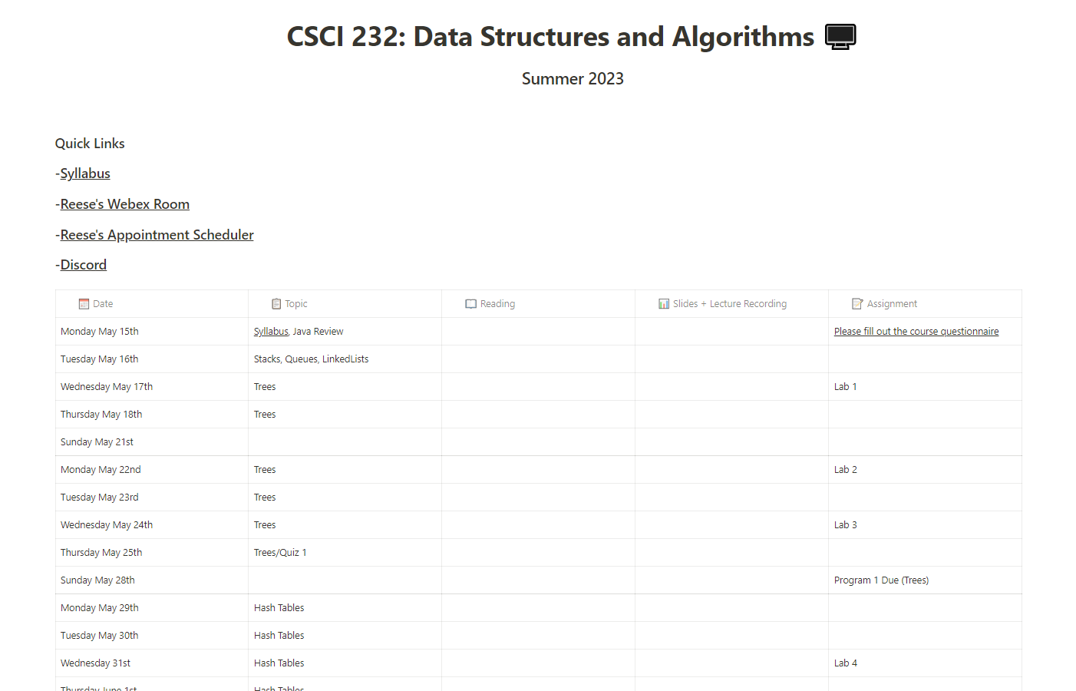
Course Logistics
You will be visiting this website a lot… be sure to bookmark it!
https://www.cs.montana.edu/pearsall/classes/summer2023/232/main.html
You also will need to join our discord server!
(This schedule will change a lot)
Get 232 notifications by typing !join-232

Slide 20
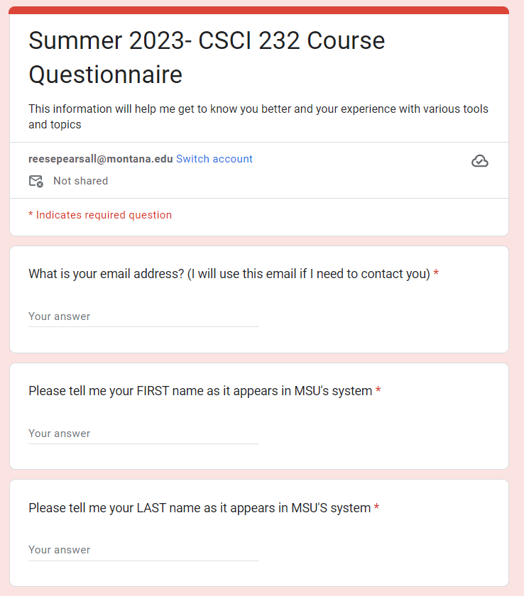
Course Questionnaire
Please take some time this week to fill out the course questionnaire ☺

Slide 21
Prerequisites
CSCI 132- Basic Data Structures and Algorithms (Required)
CSCI 246- Discrete Structures (Recommended)
*You will be totally fine if you have taken 246
Before taking this class, you should feel comfortable basic Java programming, be comfortable using the following data structures: arrays, linked lists, stacks, queues, be comfortable with basic recursion, and how to analyze an algorithm using big-O notation
(If you are not familiar with any of this stuff, you should take some time to review it this week. My CSCI 132 course is available and may be helpful)

Slide 22
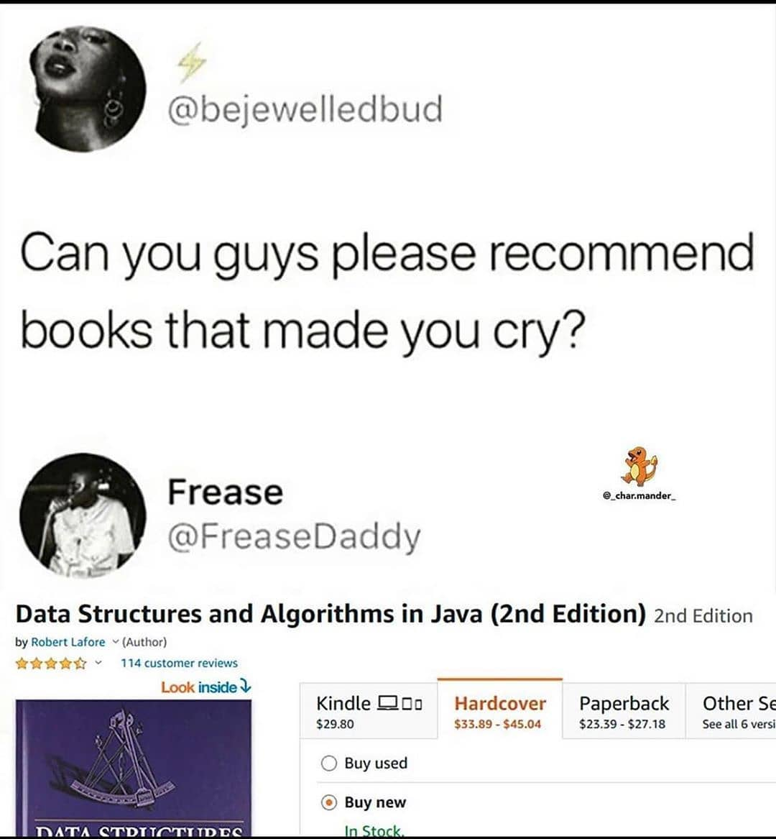
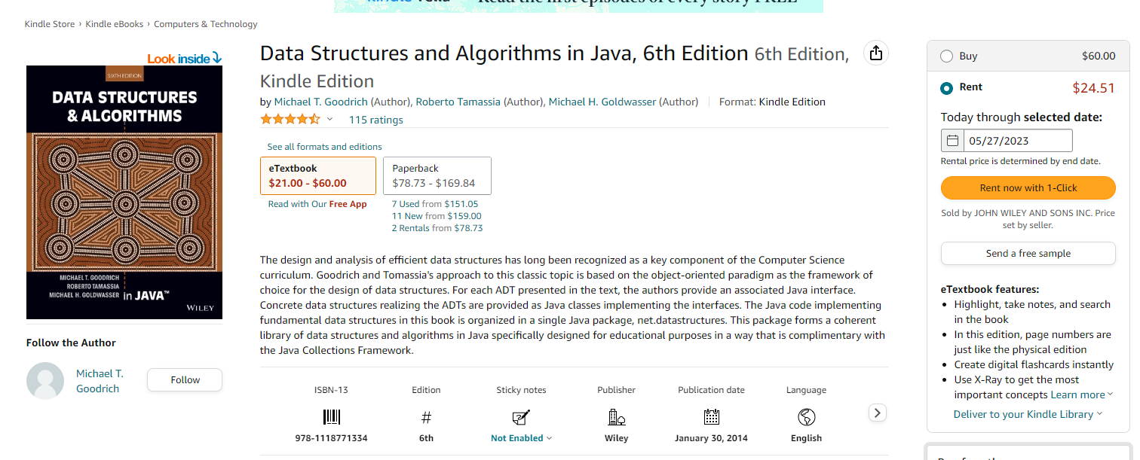
Textbook
(Optional) Algorithms (4th Edition) by Sedgewick and Wayne.
(Optional) Data Structures and Algorithms in Java, 6th Edition by Goodrich, Tamassia, and Goldwasser (CSCI 132 textbook)
unfortunately, a very relatable meme
This textbook is not required
(but it does have tons of great stuff!!)

Slide 23
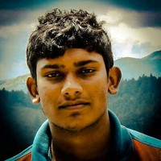
We have one TA, who will grade all your labs and programs
Adiesha Liyanage
Email: (see syllabus)
Office Hours: (see syllabus)
If you have any questions about grades, you should ask him first. He can also help with 232 assignments

Slide 24
Grading
35% - Labs (7 labs @ ~5% each, I will drop your lowest grade)
40% - Programs (4 programs @ 10% each)
15% - Online Quizzes (3 quizzes @ 5% each)
10% - Participation/Check-in

Slide 25
Grading
Labs (35%)
Shorter, weekly assignments (1-2 a week)
Can generally be finished within 1-2.5 hours
Due @ 11:59 PM on specified day to D2L (submit .java files)
I will post the labs a few days ahead of time
You can get help by coming to “lab”, office hours, or my Webex room
8 labs in total, but I will drop your lowest lab grade at the end of the semester
You can work alone or with a partner

Slide 26
Grading
Programs (40%)
Longer, more complicated programming assignments
Will likely take 2+ hours to complete
I will try to give you at least a week to complete them
Programs will usually be at 11:59 PM on the specified date (submit .java files)
Much higher stakes, make sure you give yourself plenty of time to complete them
You can get help by coming to “lab”, office hours, or my Webex room
You can work alone or with a partner

Slide 27
Grading
Quizzes (15%)
Three quizzes (End of weeks 2, 4, and 6)
Will be administered through D2L
Will open at 6 AM, must be completed by 11:59 PM
Not timed, but you only get 1 attempt
Should take less than 1 hour. Questions consist of multiple choice, true/false, and short answer, maybe a little bit of coding

Slide 28
Grading
Participations/Check-in (10%)
Helps me make sure you are keeping up and doing ok in the class
Very easy 10%. You can earn these points in a variety of ways
Attend lecture (don’t need to attend all of them)
Attend “lab” or office hours
Schedule a check-in meeting with Reese (Office hours or appointment scheduler)
If you are taking the class fully online, you need to meet with me at least twice during the summer (short check-in meeting)

Slide 29
Late assignment policy
If you submit late, but you are within < 24 of the original. You will face a -25% penalty
If you submit late, but you are within < 48 of the original. You will face a -50% penalty
Any assignment submitted 48+ hours after the deadline will not be accepted

Slide 30
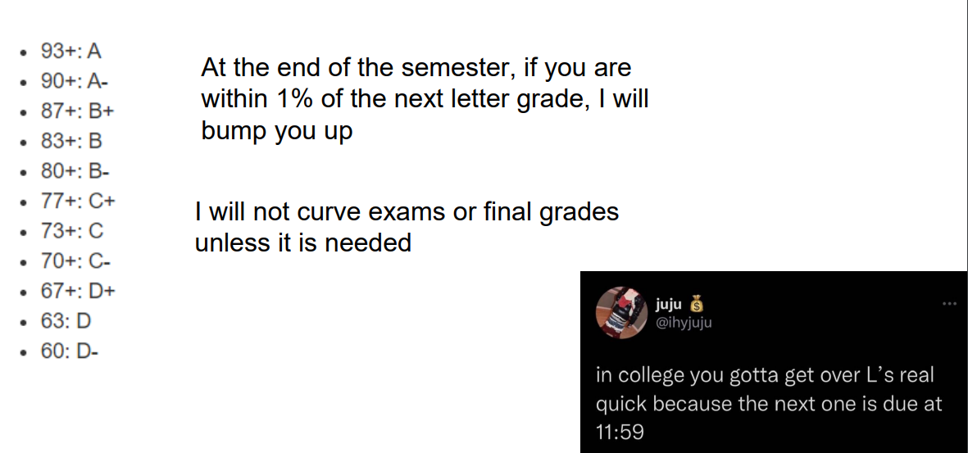
Grading Scale

Slide 31
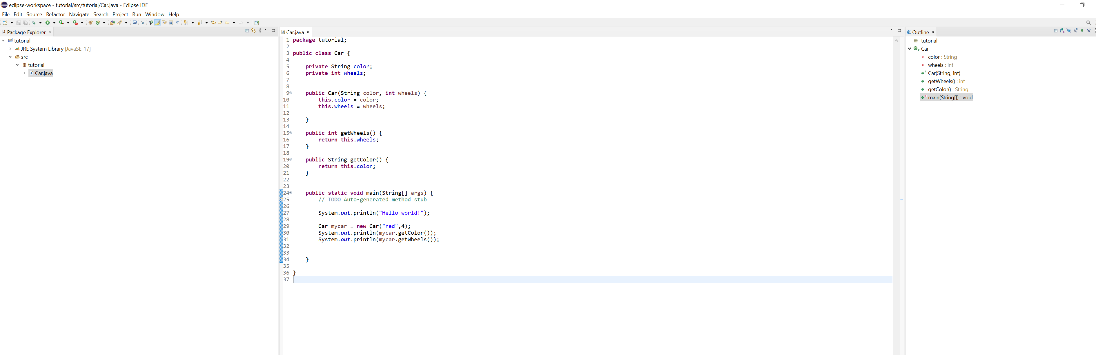
IDE
You will need to download an IDE that you can write Java programs in
Eclipse (I will use this one)
Netbeans
IntelliJ

Slide 32
Grading Deductions
You must submit code that compiles. Code that does not compile will receive an automatic 0%.
If your code compiles and runs, but doesn’t work, or has errors later on, that is ok.
Adiesha or I should not need to fix your code in order for it to compile

Slide 33
Academic Misconduct
Plagiarism and cheating is very not cool
You are not allowed to submit something that is not your own, and you are not allowed to steal solutions from another person and modify it
I have a Chegg and Course Hero membership. Don’t try it
Using small snippets of code from the internet is acceptable (but should not be needed). If you do use a small snippet of code from the internet, you should leave a reference as a comment in your code
Do not use any tools or AI that will write code for you

Slide 34
Collaboration Policy
All labs will be individual submissions.
For programs, you are allowed to work with one partner.
When it comes to labs, you may
Share ideas with other students in the class.
Work together on labs in the same physical location.
Help other students troubleshoot problems.
Give hints or provide textbook page numbers/slide numbers to students seeking help
You may NOT
Share your code and solutions directly with other students.
Submit solutions that you did not write.
Modify another student's solution and claim it as your own.
Share your report or solutions directly on Discord

Slide 35
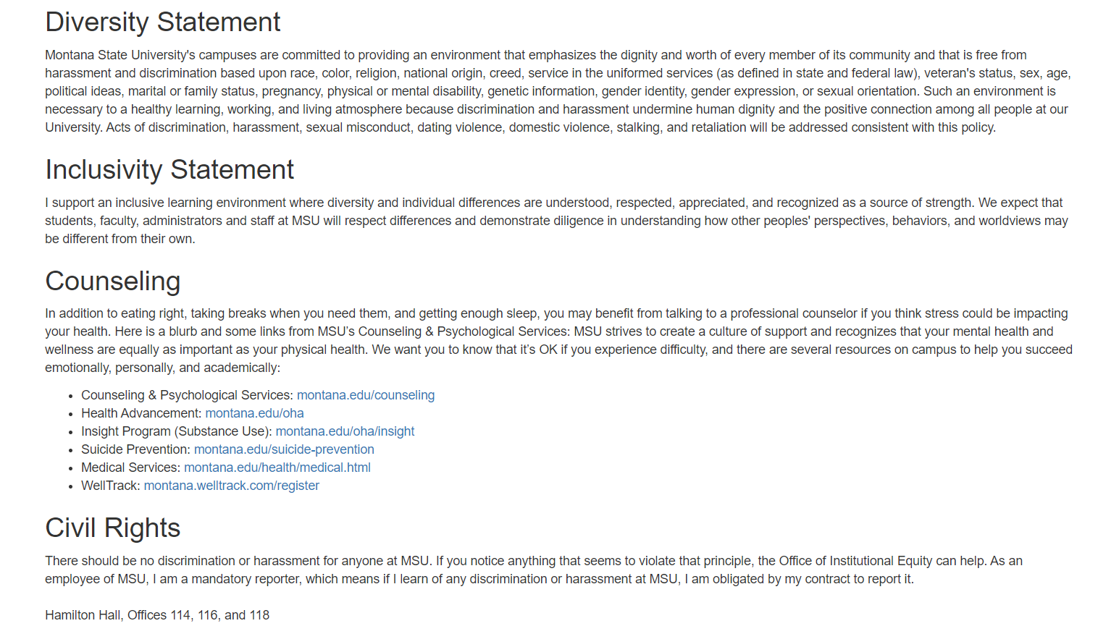
Additional MSU Resources:
https://www.cs.montana.edu/pearsall/classes/msu_resources.html

Slide 36
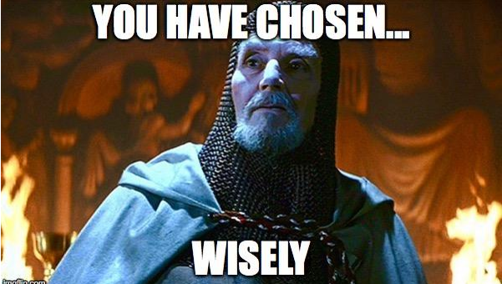
How to do well in this class
Keep up. Come to class or watch the lectures the day of
Get started on assignments early (especially programs)!
Get help when you need it
Enjoy your summer first

Slide 37
Questions?

Slide 38
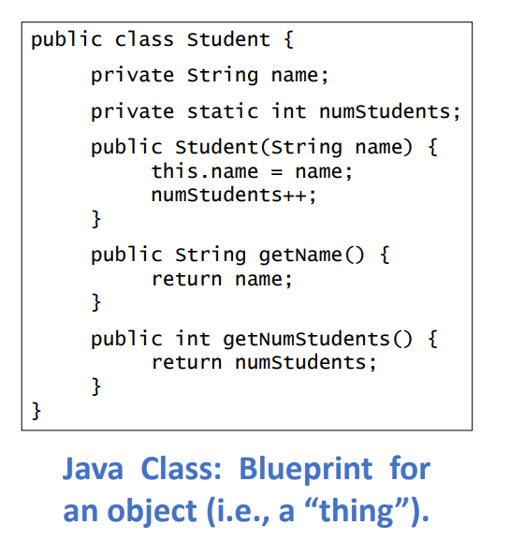
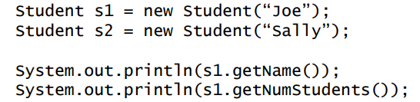
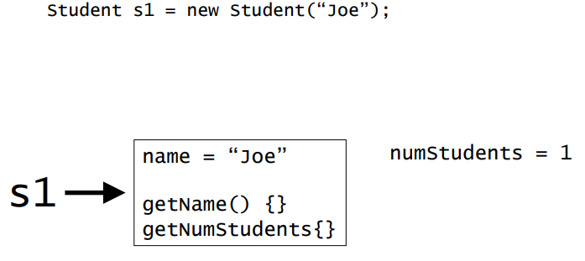
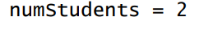
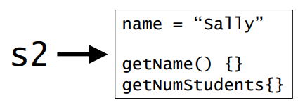
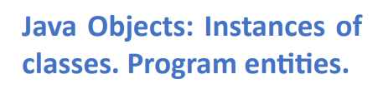
Student.java
StudentDatabaseDemo.java

